Slide 1
A community aspect of wireless networking technology
The case of Sarantaporo.gr Wireless CN
Vassilis Chryssos
#otheranthropolitics, April 2019,Volos

Slide 2
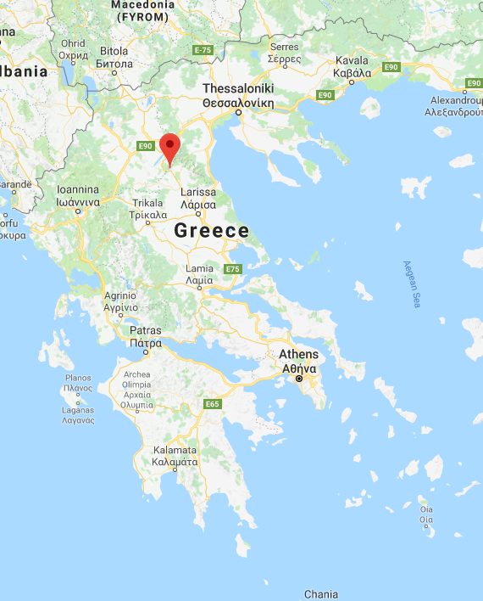
Background info on Sarantaporo(.gr WCN)
Sarantaporo village, central GR
Since 2010
No telcos in the region
Rural, isolated, mountainous area
Initiated by a group of people stemming from Sarantaporo village
Volunteers - driven
Sarantaporo.gr NPO founded in 2013

Slide 3
Vision
A lively, creative, booming and solidary Greek province, which provides its people with opportunities and motivation to stay in their birthplace, and enjoy a flourishing life in a sustainable and environmentally friendly manner.
“

Slide 4
Mission
To eradicate digital divide and provide local communities with equal opportunities for access to the digital economy and citizenship
“

Slide 5
What is a Community Wireless Network?
Community (Wireless) Networks (CNs) are "communication networks built, owned, operated and used by citizens in a participatory and open manner"
"The rise and fall and rise of the community networks"
Steve Song, Carlos Ray-Moreno, Anriette Esterhuysen, Mike Jensen & Leandro Navarro, GISWatch 2018
“

Slide 6
What we do
Building a common telecommunication infrastructure
backbone layer: interconnecting villages & other POIs
access layer: provide open Internet access to people
Training locals
basic ICT, networking & computer networks
digital literacy (privacy, security, digital tools)
Community building

Slide 7
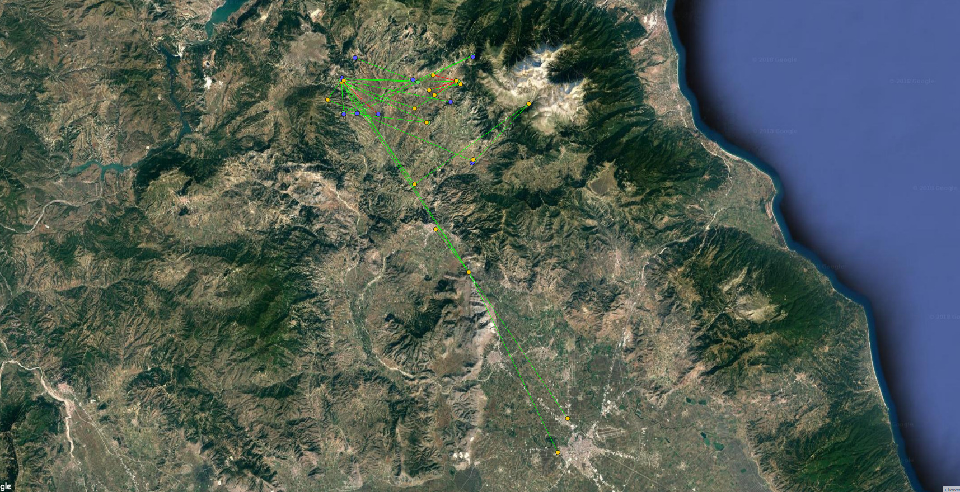
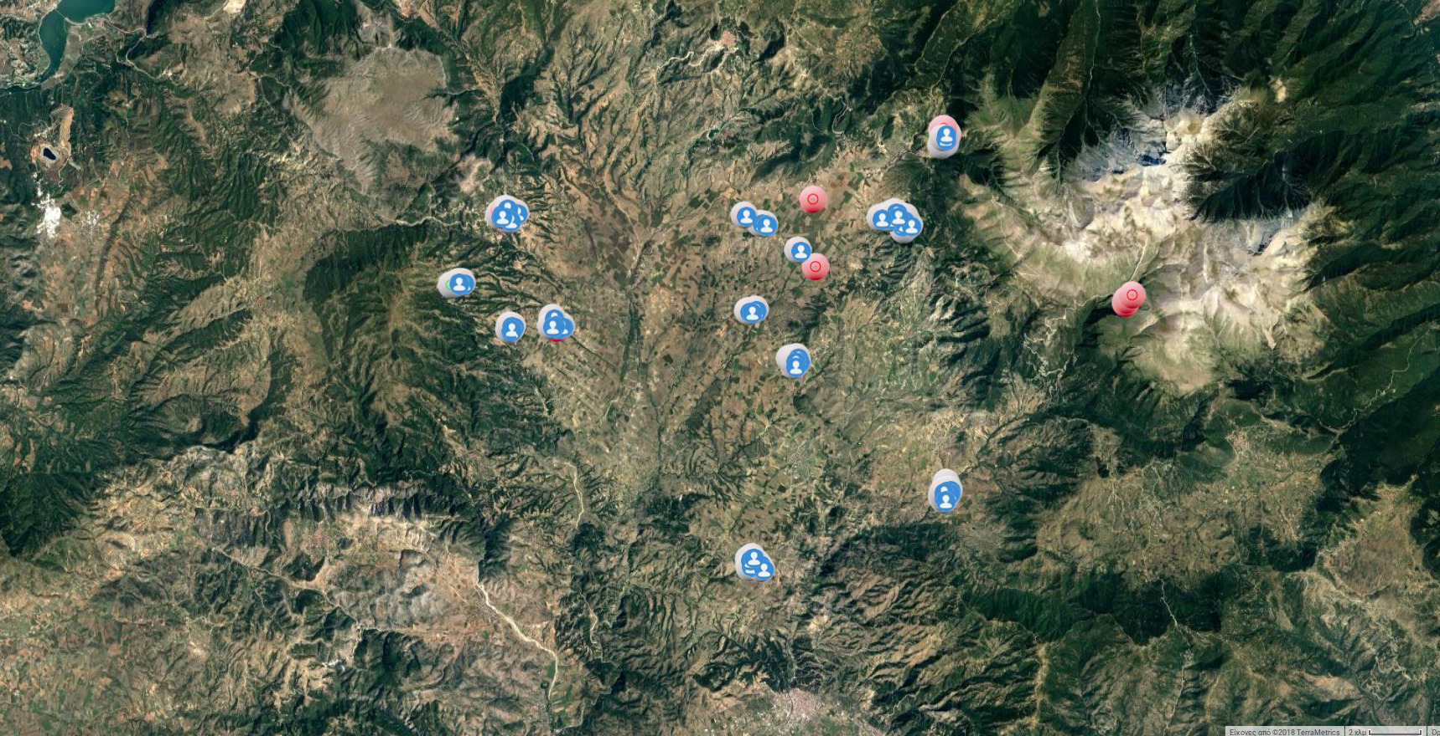
Sarantaporo.gr CN in numbers today
https://wind.sarantaporo.gr
https://wifi.sarantaporo.gr
Backbone Network - 20 Nodes
Access Network - 199 APs
11 villages + 3 Farms + 1 camp
20 backbone nodes (i.e. with multiple links)
37 total nodes
49 point-to-point connections
126 public Access Points
73 private Access Points
50 local community members involved in network expansion and maintenance
Notes:
Serving local communities, expanding rapidly

Slide 8
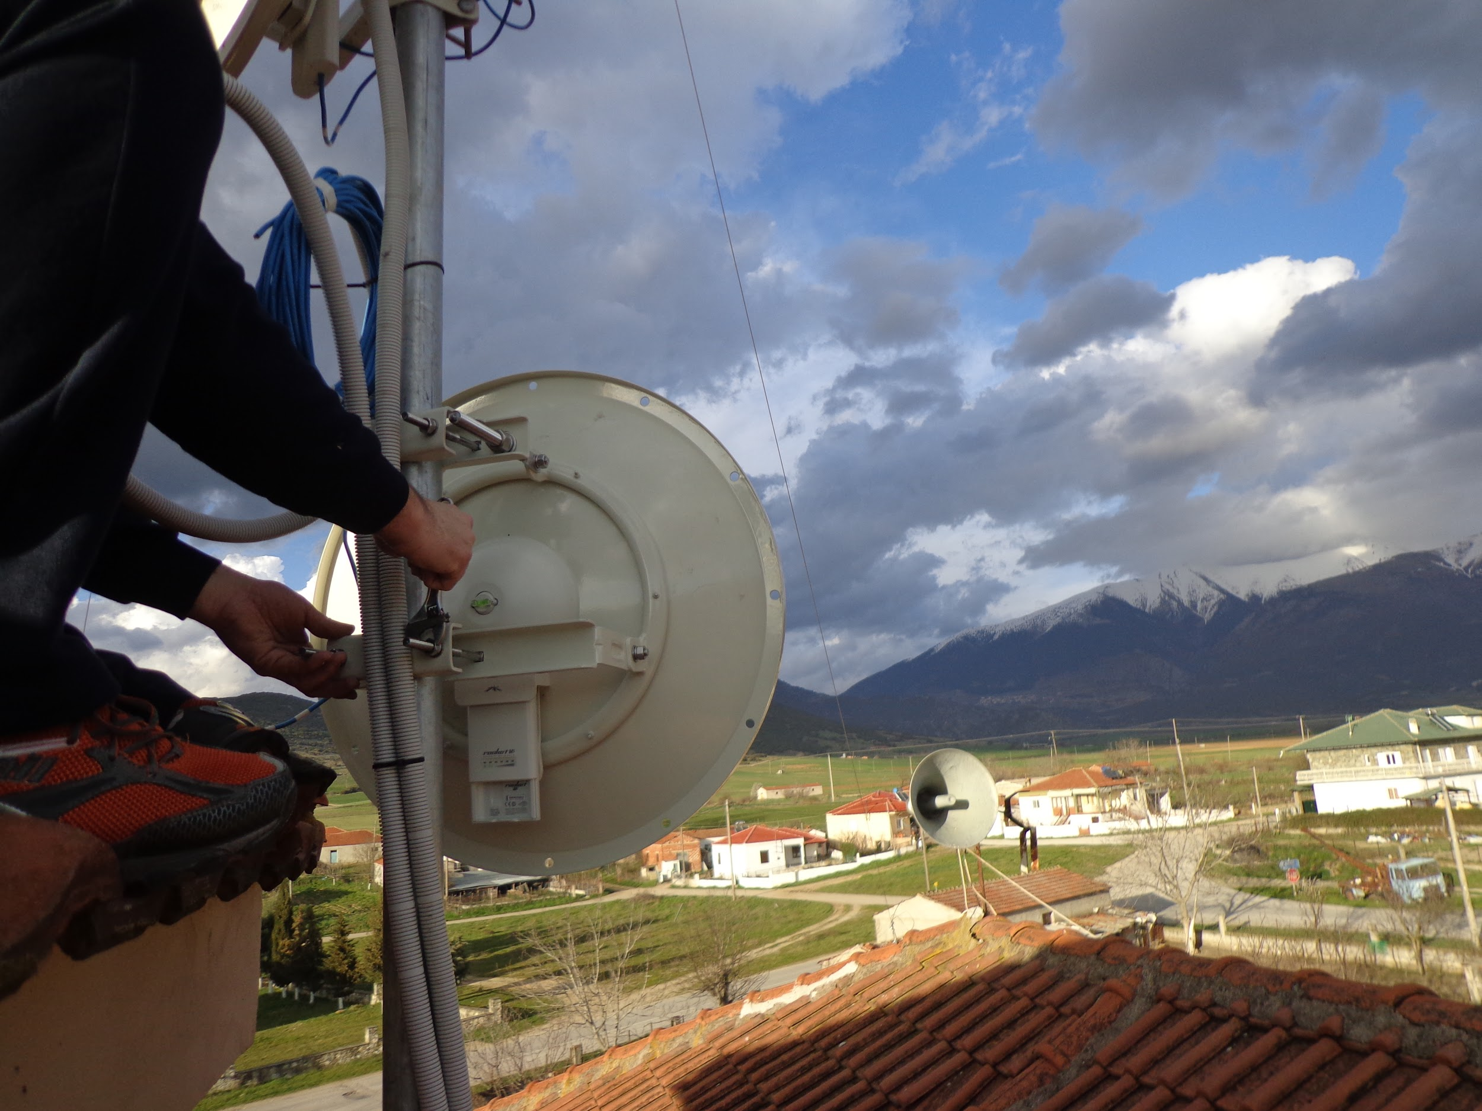
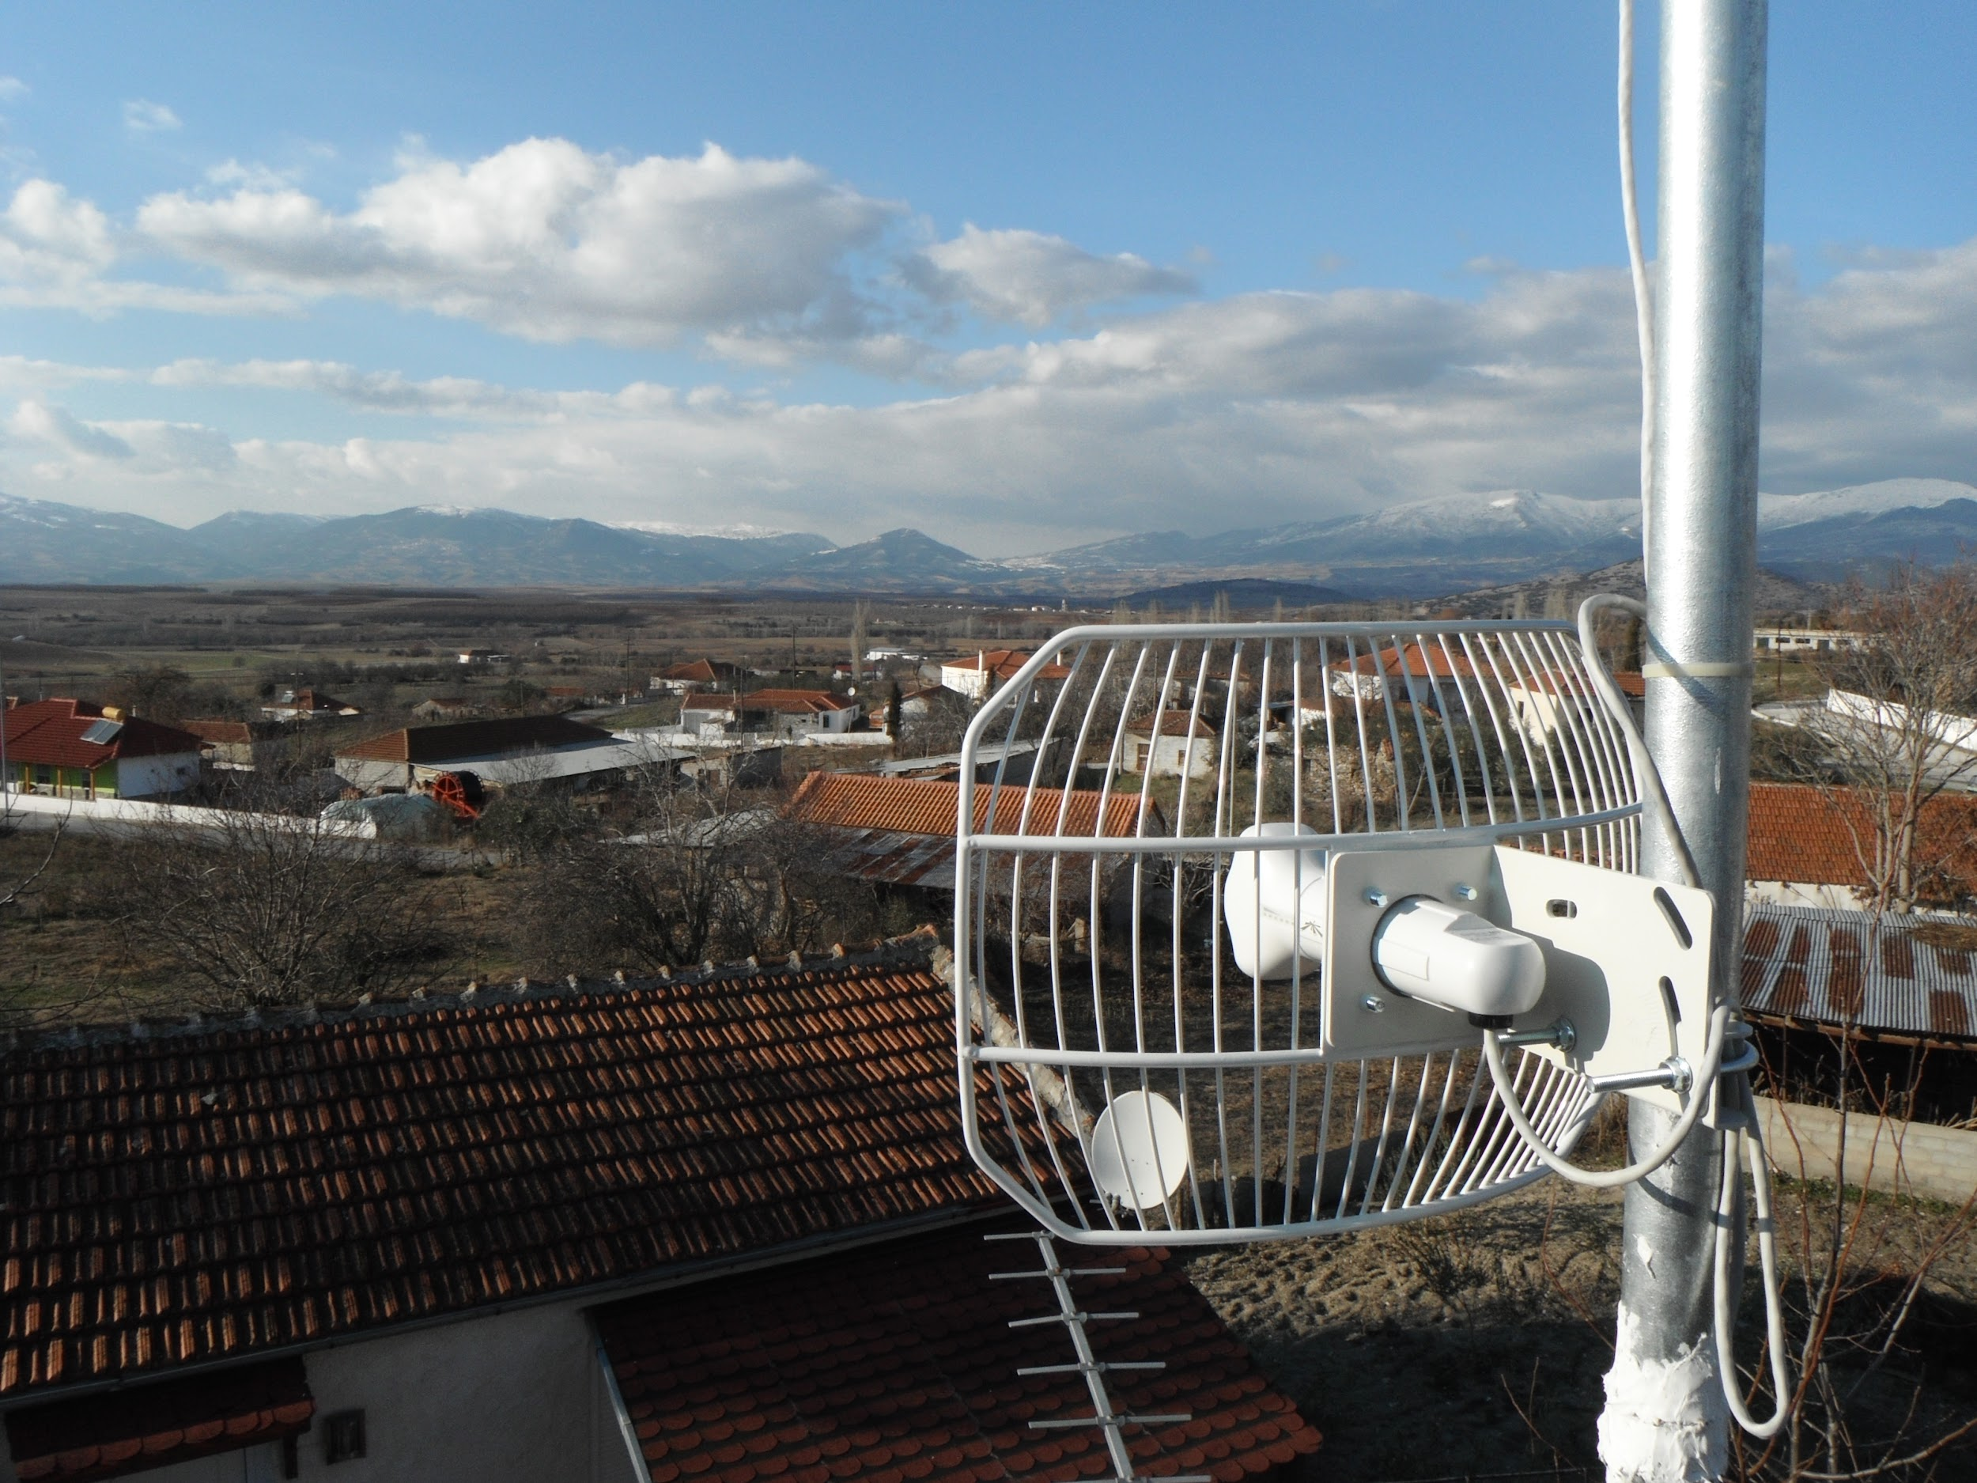
Notes:
Community infrastructure for Open Access Internet Connectivity

Slide 9
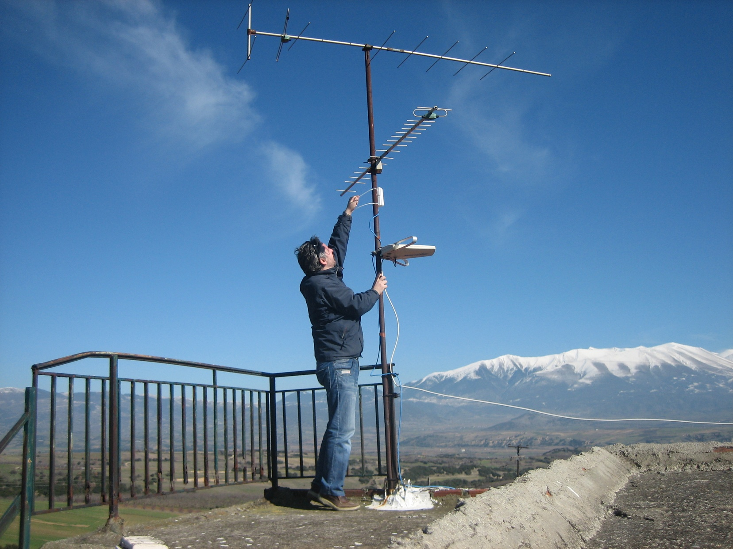

Slide 10
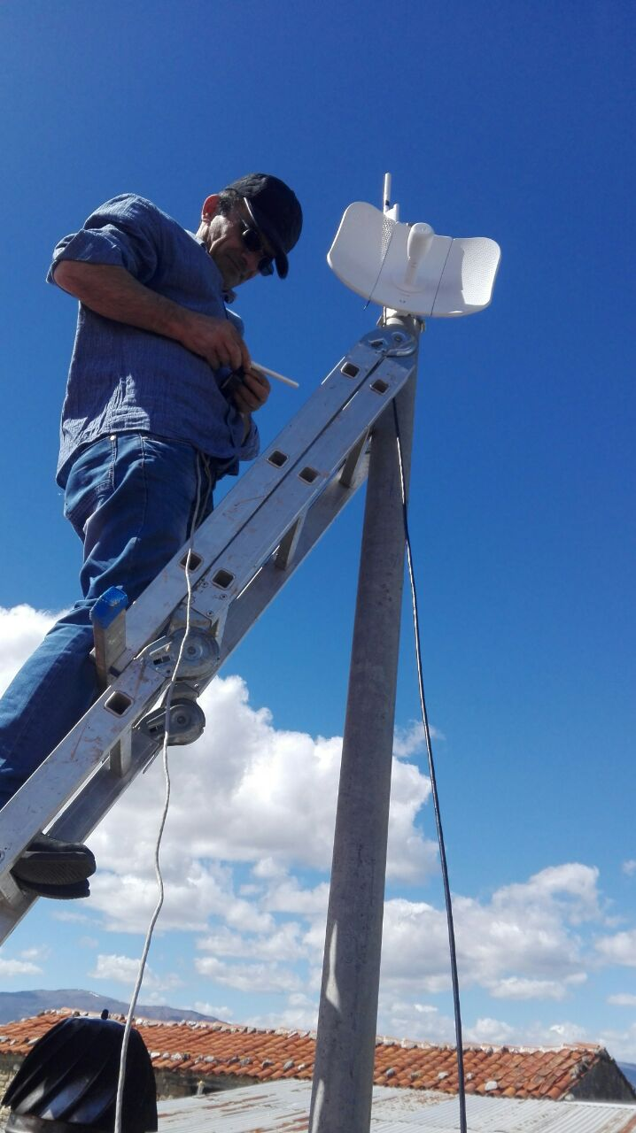
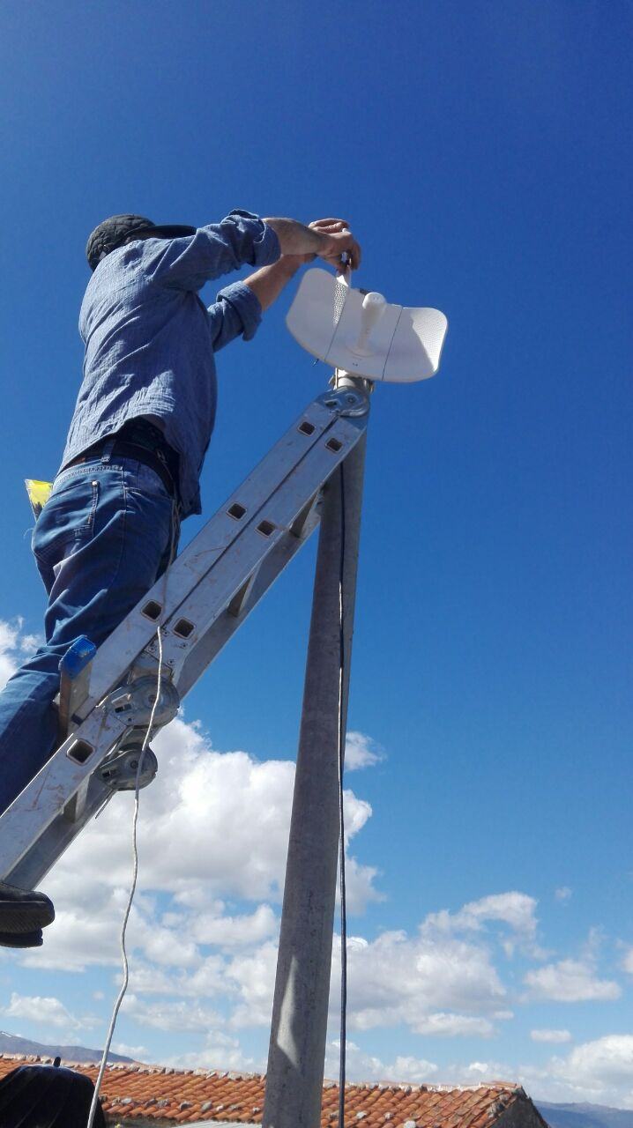

Slide 11
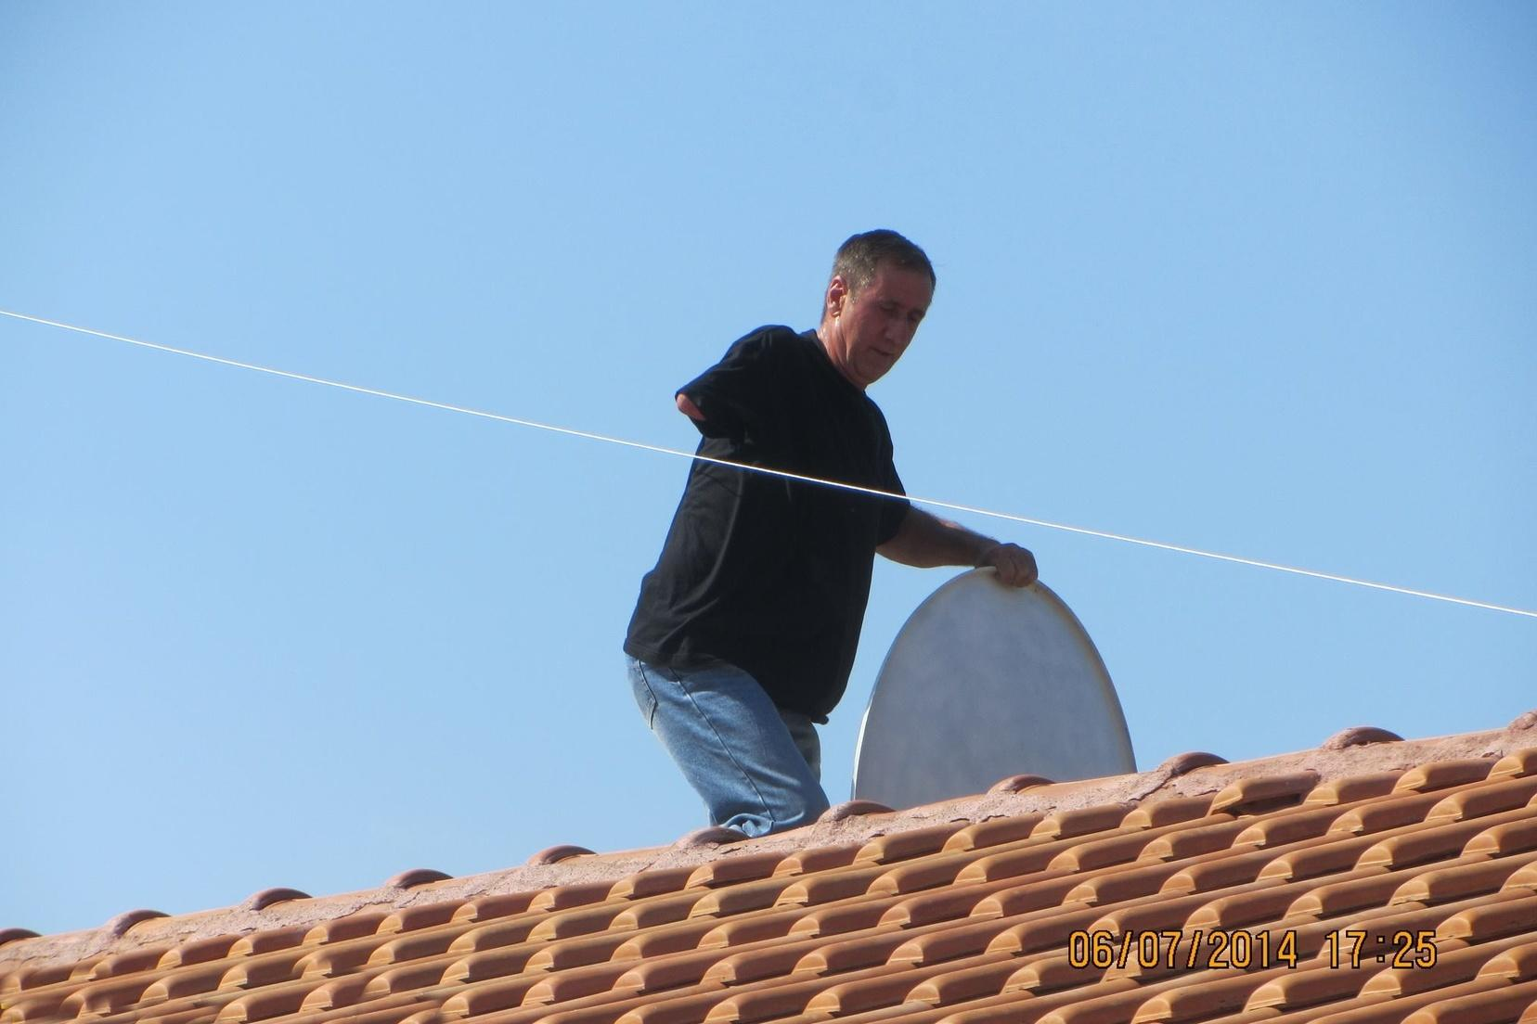
Notes:
Along the way, some people with disabilities also participated in setting up the infrastructure.

Slide 12
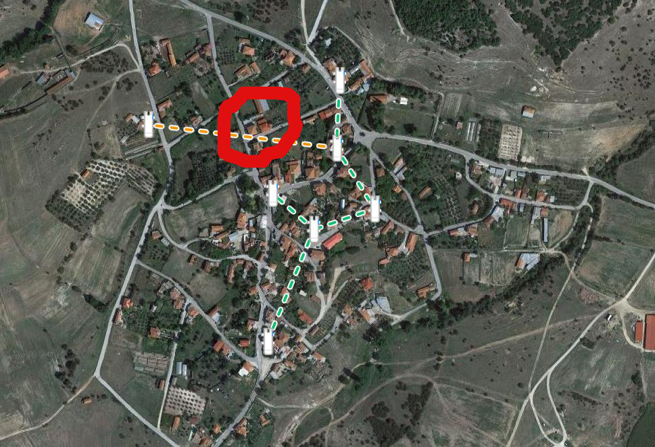

Slide 13
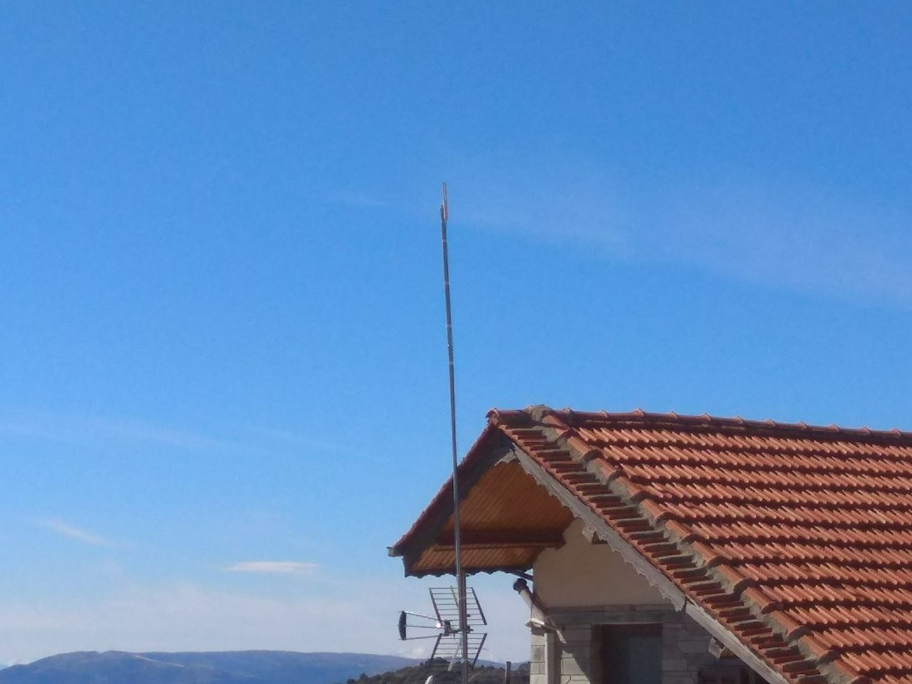
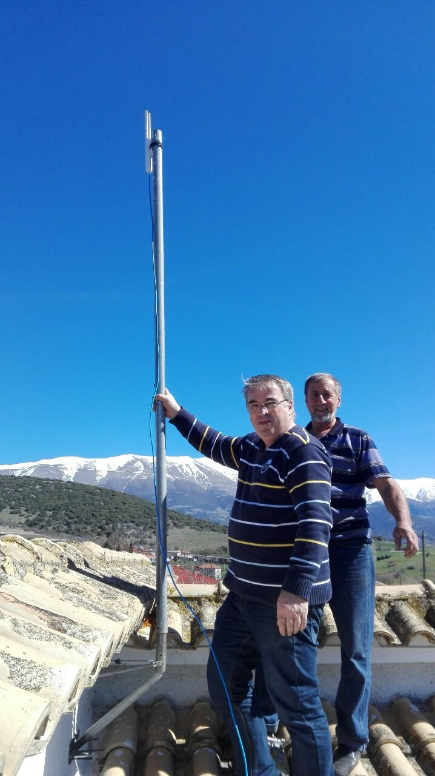

Slide 14
Training
Main challenge: distance and communication
Training workshops almost every three months for 2018/2019 in different village every time.
Train the local community members
Train the trainers
Funded by ‘Beyond the Net’

Slide 15
Training
Empower local people to:
build, maintain and expand their village’s network
safely and securely use the Internet
become aware of digital opportunities to improve their lives
Funded by ‘Beyond the Net’

Slide 16
Workshop in Flambouro village, 03/2018
How to make an ethernet cable
Automatic and static IP assignment on my computer
Backbone and access layer architecture - Difference between Point to Point (P2P), Point to Multi Point (PtMP), mesh (on a map with tokens)
WiFi bands, channels, WiFi signal, WiFi analyser, IP tools apps
Basic troubleshooting tools (e.g ping,traceroute/tracert, mtr)
Using AirOS & Powerbeam to create a wireless link

Slide 17
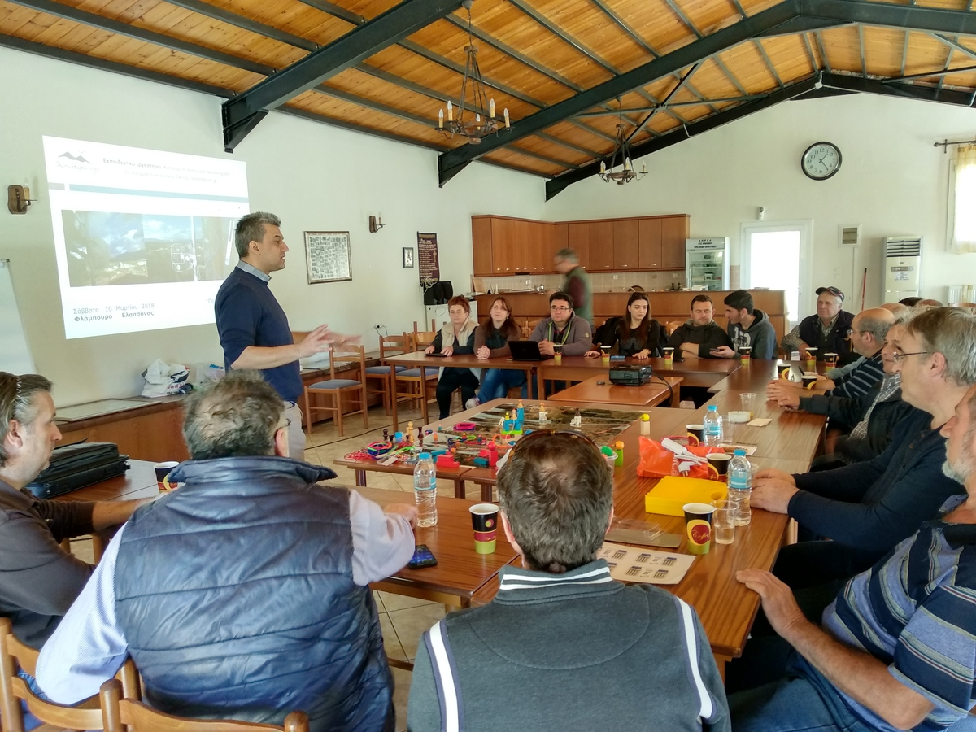
Notes:
Need for training / workshops. Challenge: multiple stakeholders / needs.

Slide 18
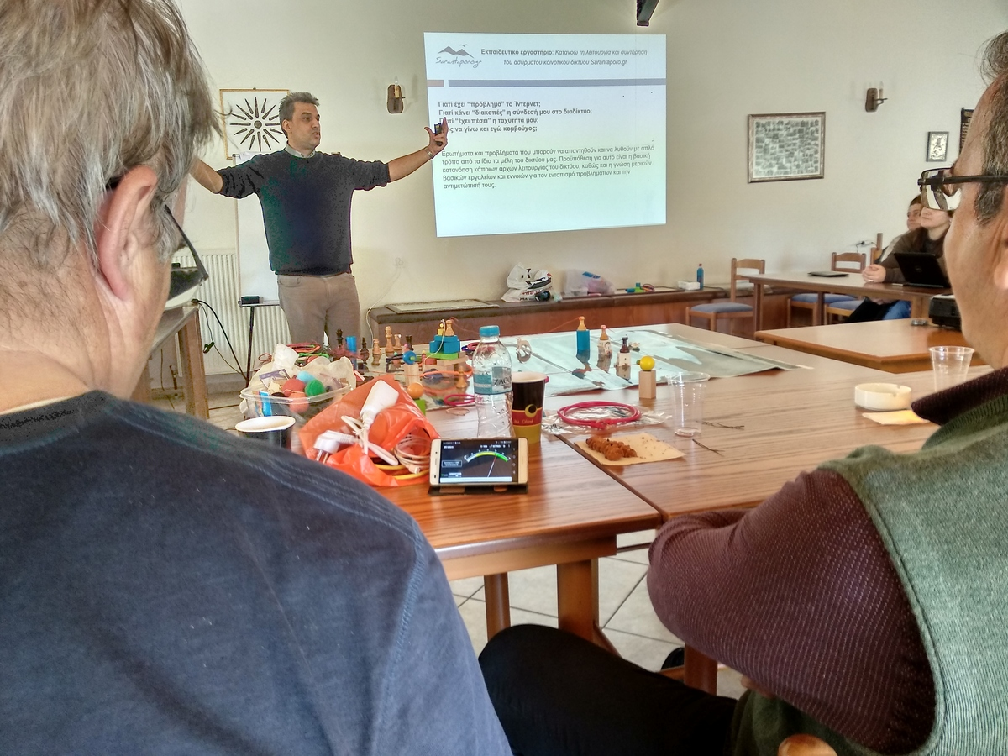
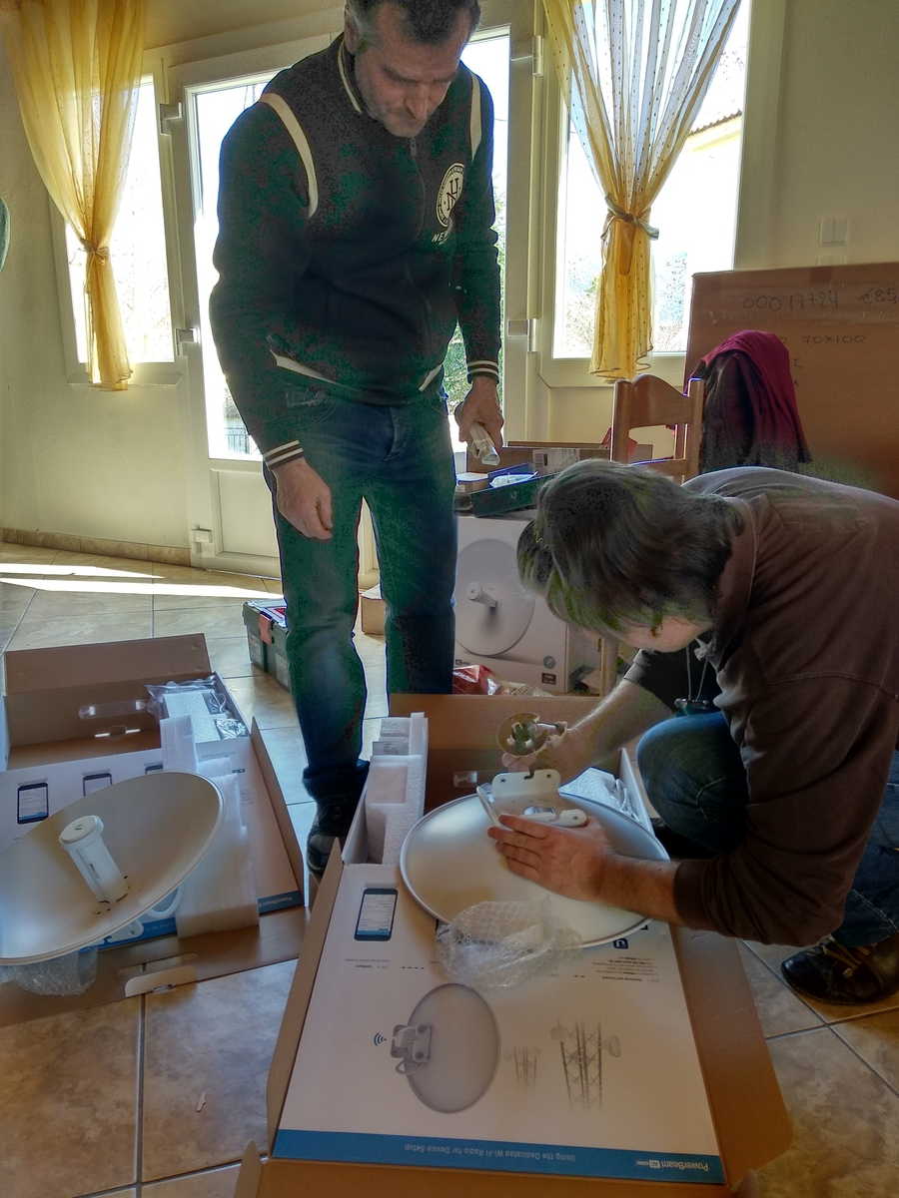

Slide 19
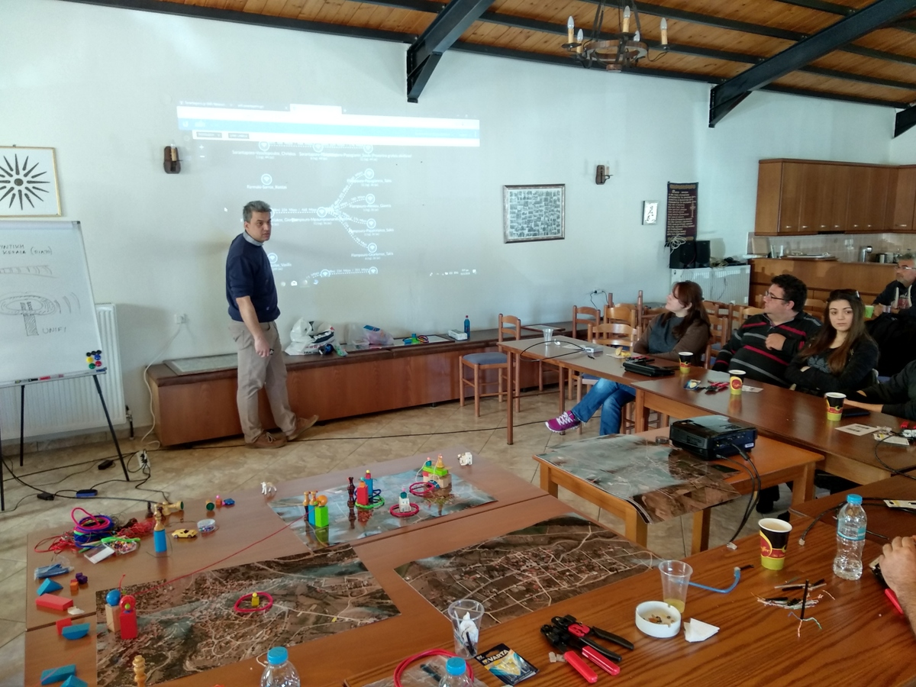
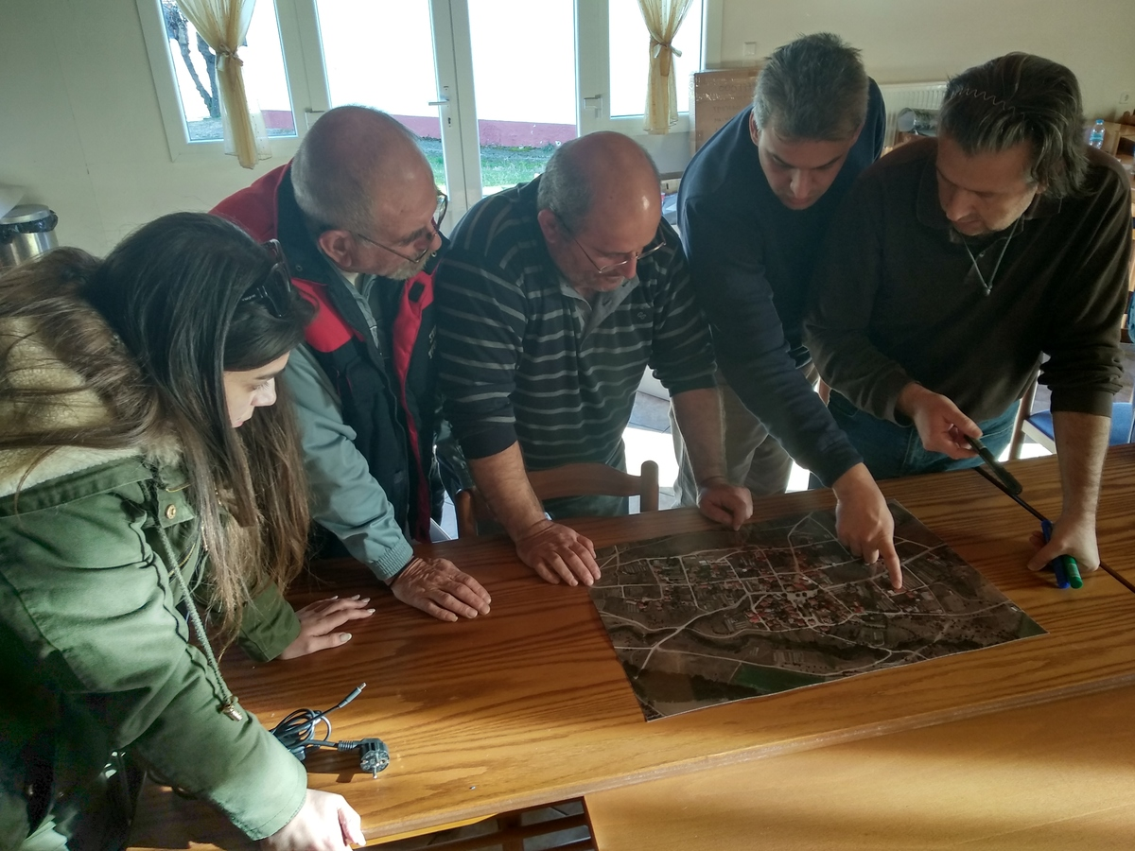
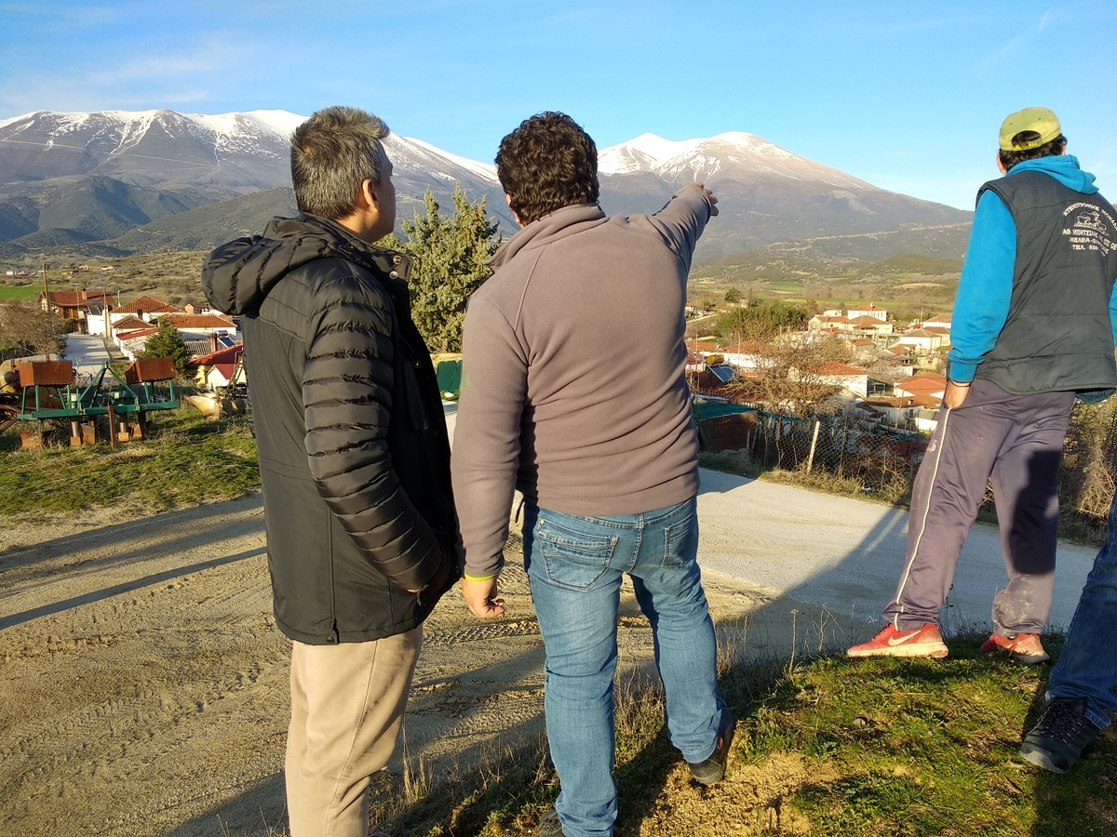

Slide 20
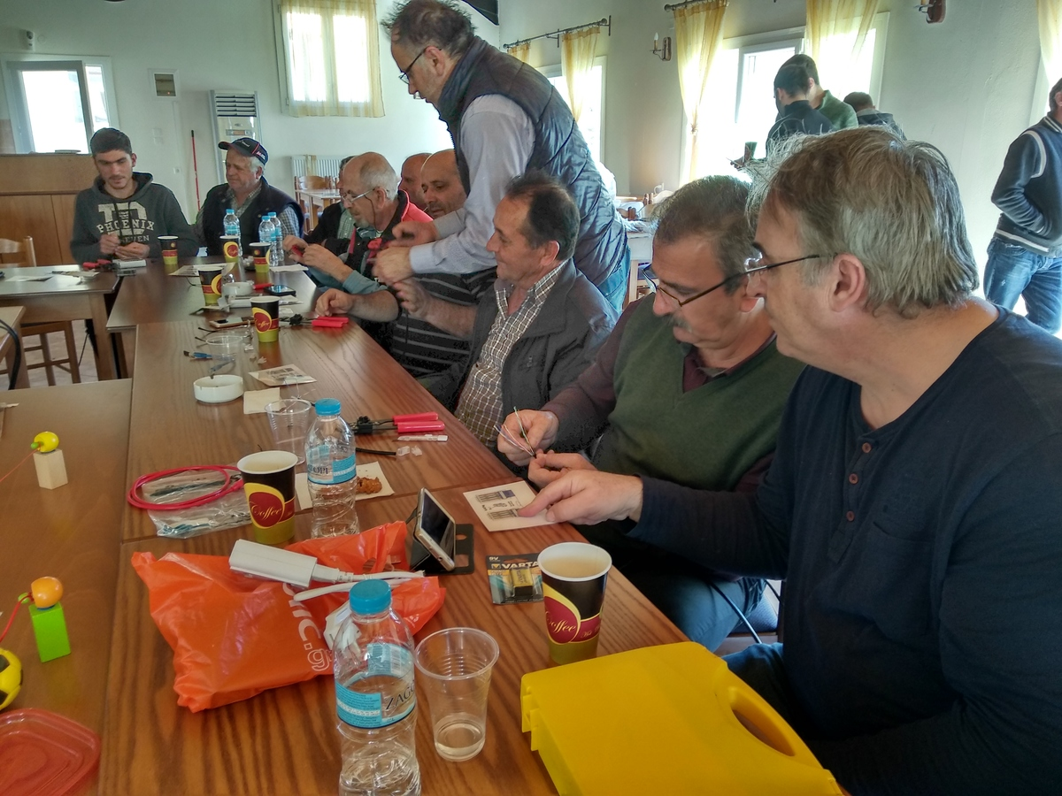

Slide 21
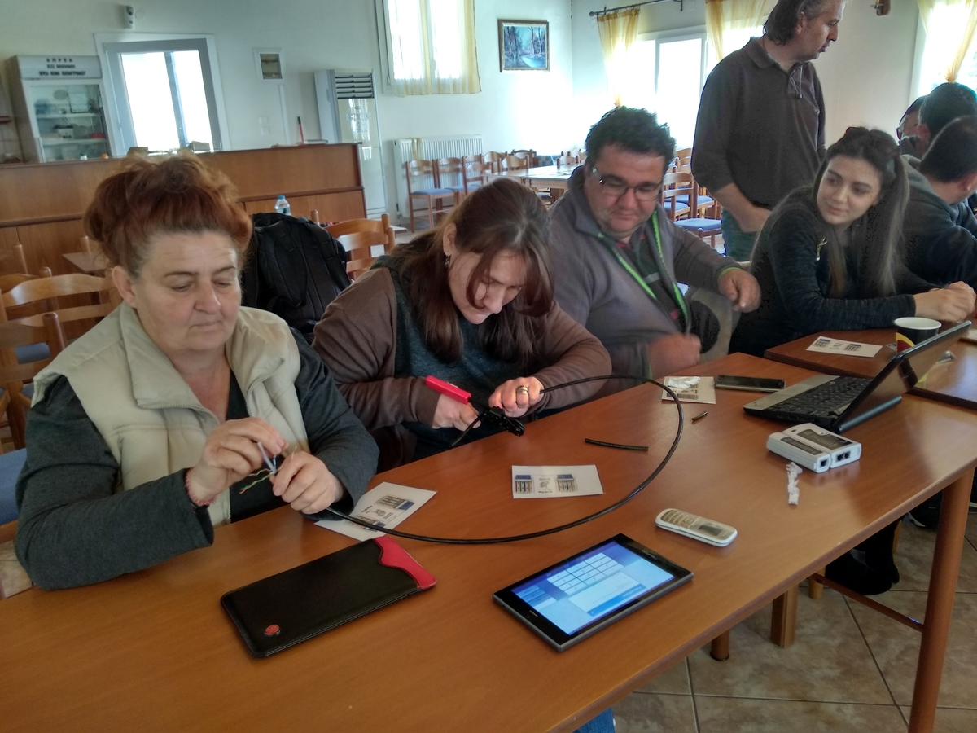

Slide 22
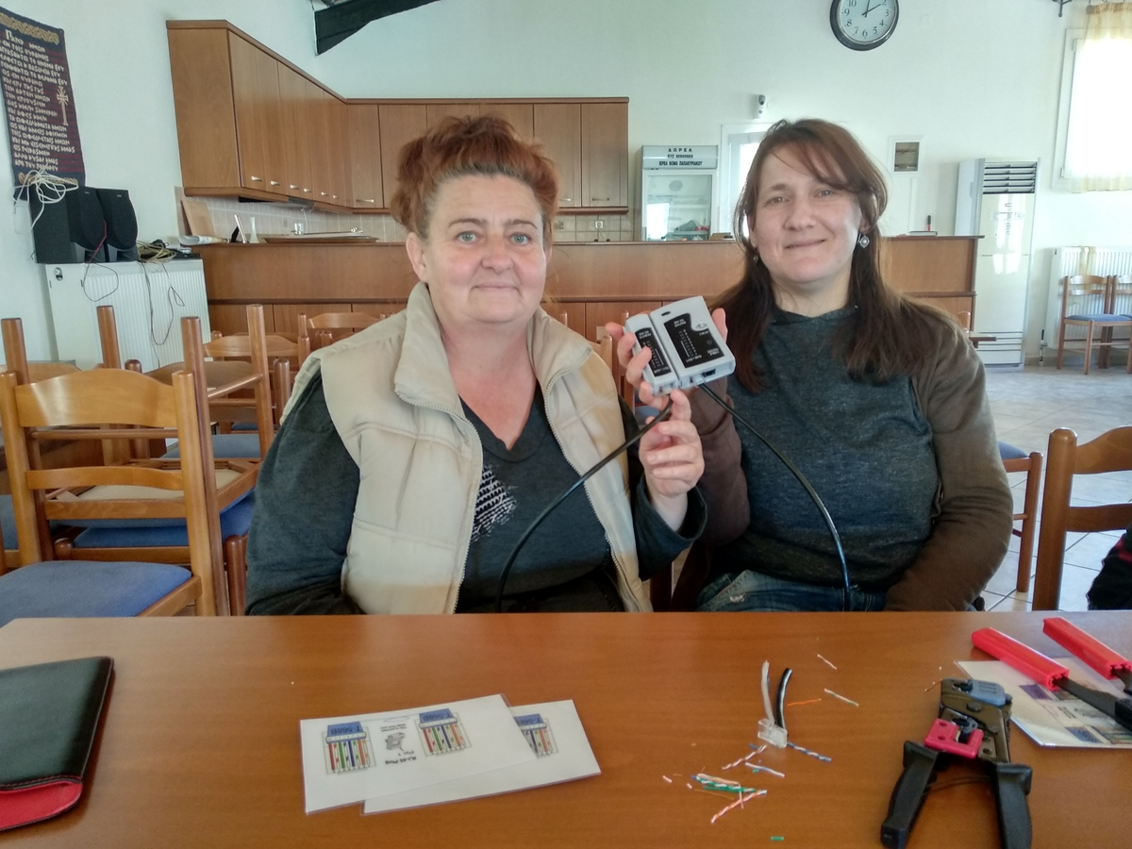

Slide 23
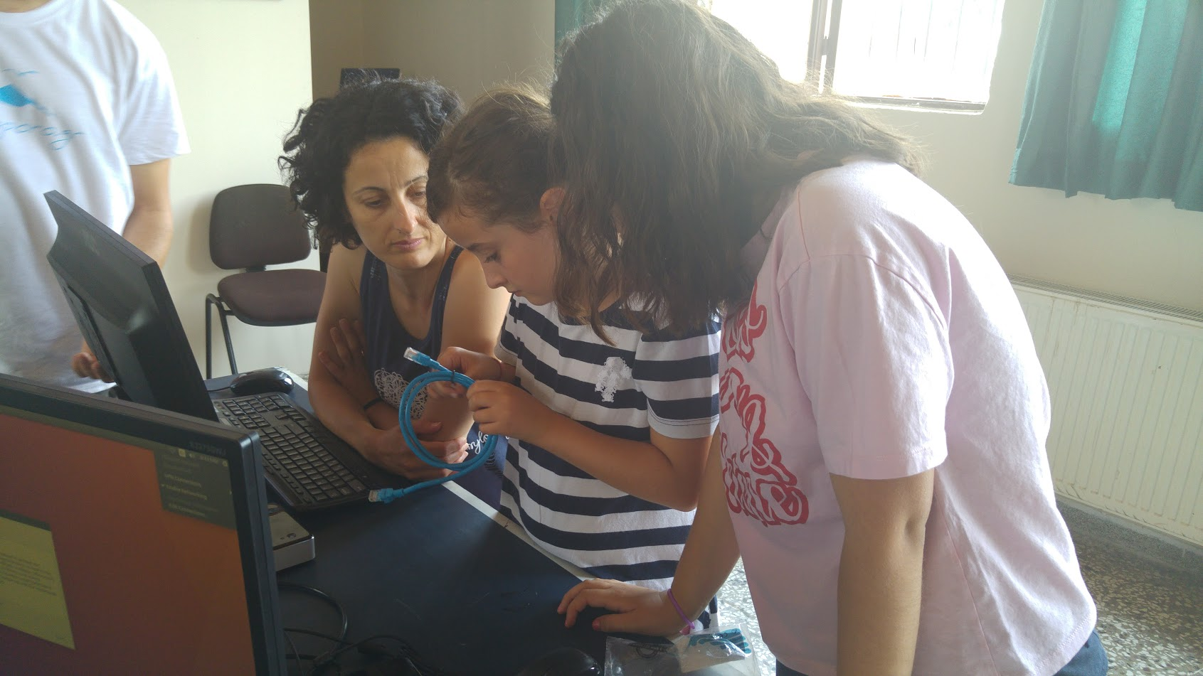

Slide 24
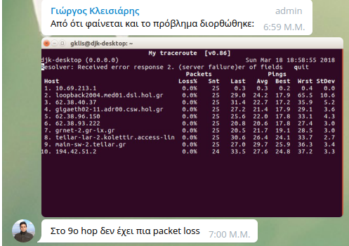
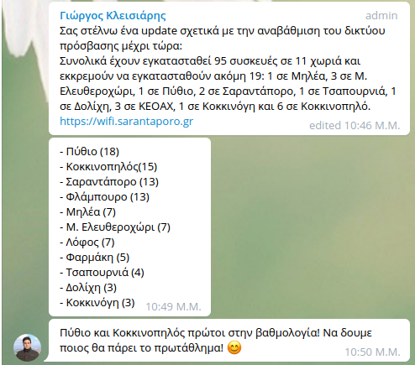
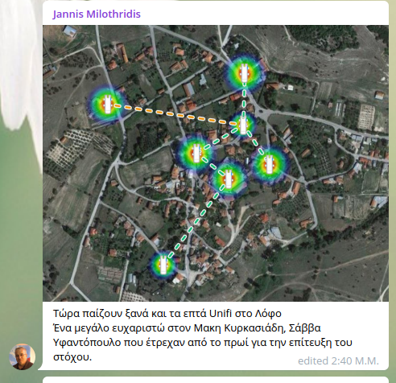
Best practices
Support
Update on progress
Celebration

Slide 25
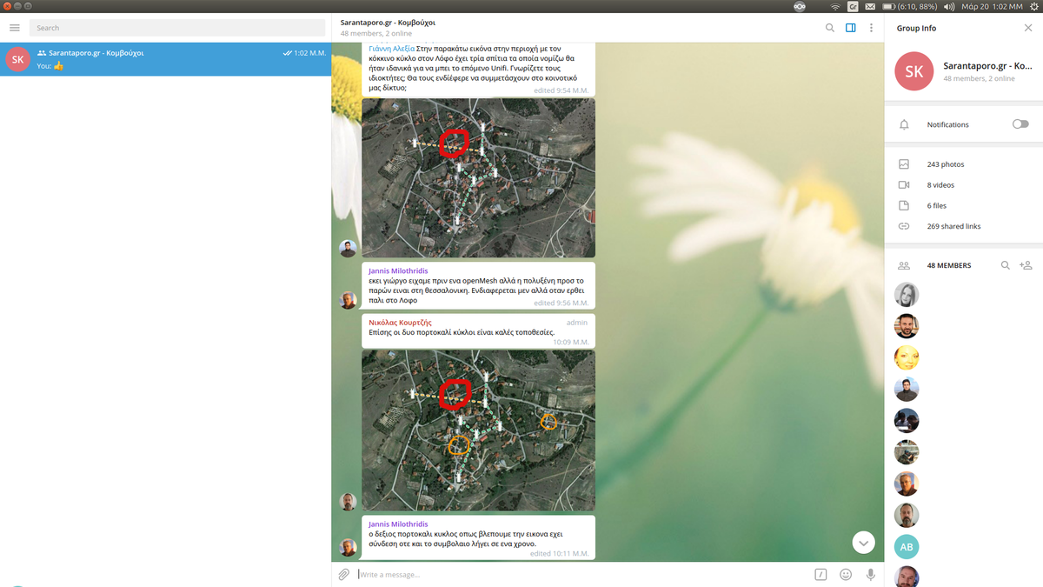

Slide 27
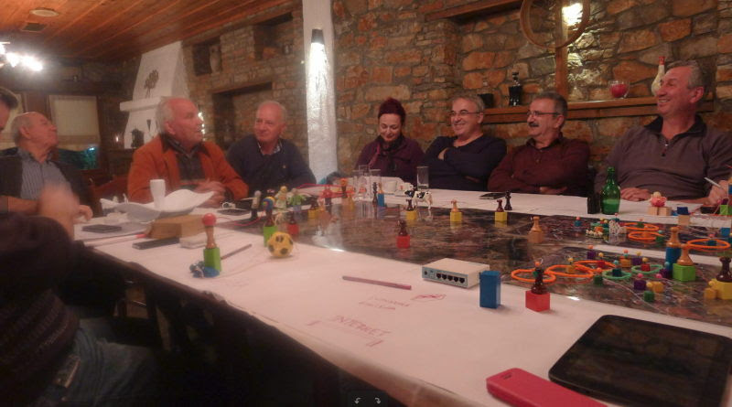

Slide 28
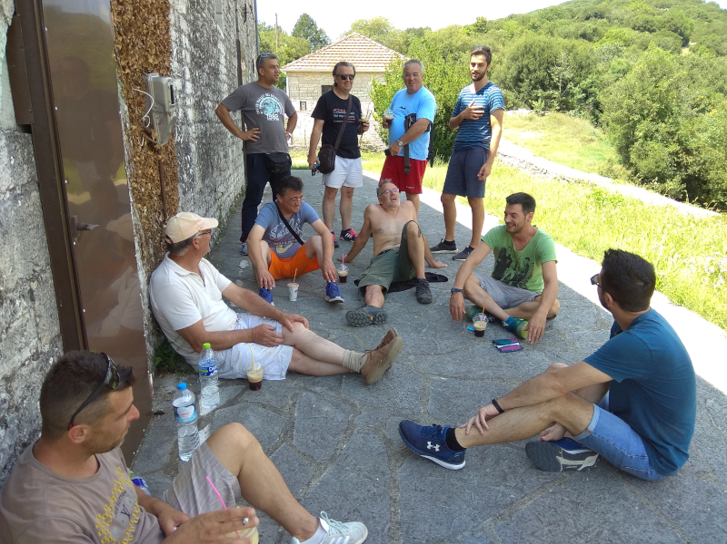
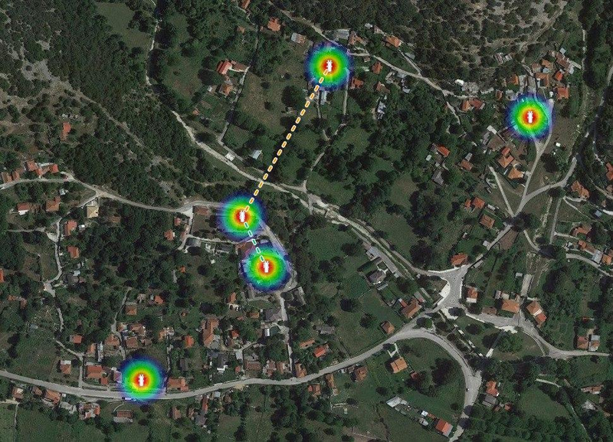
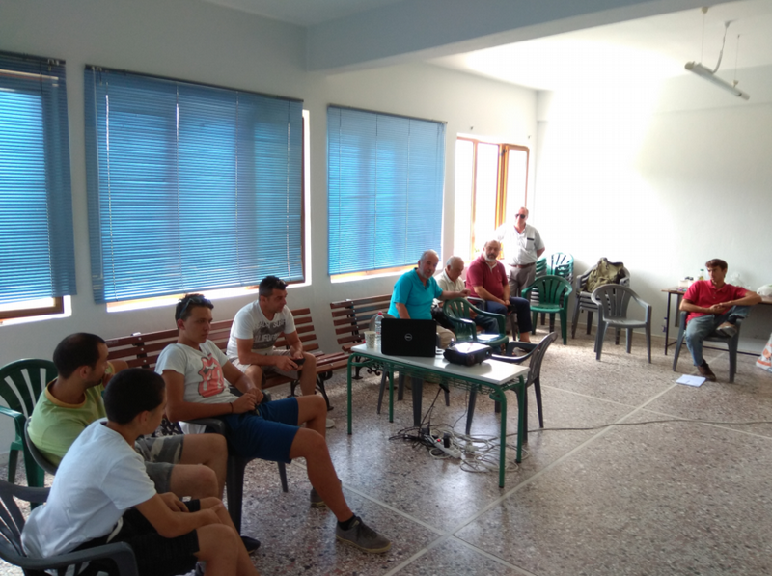
Expertise transfer to other communities

Slide 29
Best practices
Best practices contribute to the transformation of locals from consumers to active, engaged, informed citizens.
“

Slide 30
Insights
WiFi and Internet connectivity quality are important
Relevance with locals’ lives and activities is a prime motive for people to actively engage, e.g. elders’ participation driven by the need to have their grandchildren visiting
Learning about computer networking helps build awareness on privacy and personal data

Slide 31
Insights
People do not lose patience or get frustrated when they are informed of the situation
Trained members feel proud to contribute

Slide 32
The magic
Locals build riding club node saving them thousands of €
Older members assisting newer members
Following workshops organized by locals
Women participating, despite the “tech character”
AppLea: a local mobile app for agricultural activities
Telegram group active (since:Aug. 9, 2017: 68 members, 777 photos, 556 links shared)

Slide 33
The magic
Telegram app becomes a tool to share agricultural experience
Farmers’ data: a very advanced debate on the value of farming data and ownership
Collective purchasing of fertilizers
Crowdfunding to buy a router for (the house of) a disabled fellow villager

Slide 34
Exciting results until now!
Local communities expanding own infrastructure, when and where they need it
Self-organized training sessions
Enabling medical services: medicine prescription
Empowering local economy: animal farms, agriculture
Enhancing social cohesion: grandchildren stay longer, teleconf with relatives, streaming local festivities,
Strengthening citizenship: access to digital public services

Slide 35
Next steps (2019)
Systematize workshops & training (privacy, security awareness)
Expand network infrastructure to neighboring farms
Upgrade backbone network to increase resilience (solar+UPS)
Enable eduroam in Sarantaporo.gr CN
Experiment with smart farming (remote soil moisture sensors)

Slide 36
Thank you!
Vassilis Chryssos (@vchryssos)
vchryssos@sarantaporo.gr
https://www.sarantaporo.gr
https://wind.sarantaporo.gr
https://wifi.sarantaporo.gr
Supported by:

